Slide 1



Minesweeper Solver
Shawn Frye and Ollie Bland
Oct 24, 2023
This Photo by Unknown author is licensed under CC BY-SA-NC.
This Photo by Unknown author is licensed under CC BY.
Notes:
Good Afternoon Everyone, My name is Ollie Bland and my group partner today is Shawn Frye. The project that we chose is a Minesweeper solver

Slide 2
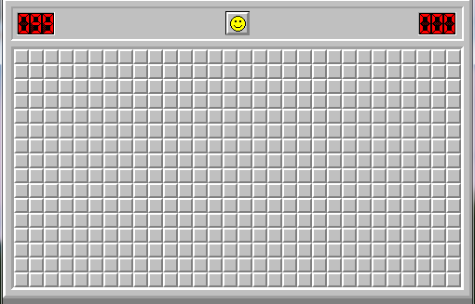
What is Minesweeper
Minesweeper is a logic puzzle game. The game features a grid of clickable tiles, with hidden "mines" scattered throughout the board. The objective of the game is to clear the board without detonating any of the mines. The numbers on the board serves as clues to how many mines are a neighbor to that number.
Minesweeper indeed demands strategic thinking and logical deduction to clear the tiles without hitting a mine. However, despite its reliance on logic, certain situations in the game cannot be resolved without making a guess, introducing an element of chance that makes achieving a 100% win rate impossible, even for the most skilled players.
This Photo by Unknown author is licensed under CC BY-NC.
Notes:
What is Minesweeper, Minesweeper is a logic puzzle game, with a grid of clickable tiles that contains mines scattered throughout . The objective of minesweeper is to clear the board without detonating any of the mines. After a players makes their first move, random number appear on the board and they serve as clues to how many mines are a neighbor to each number.
tile
Minesweeper is a game that require strategic thinking and logical deduction as you are playing in order for you to clear all the tiles without hitting a mines. However, since the puzzle has situations where you making guesses is unavoidable, it is impossible for even the most skilled players to achieve a 100% win rate.

Slide 3
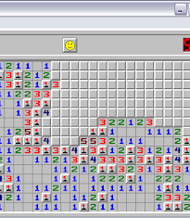
How To Play?
Using the Numbers:
Each number on a revealed tile tells you how many mines are adjacent to that tile. The range of mines around a number can be any number from 0-8. Using this information the player can infer the location of the mines.
Strategies for Success:
Start by clicking on a corner or edge of the board to open up the largest area.
Look for guaranteed safe moves and obvious mine placements based on the numbers.
Use process of elimination and patterns to infer mine locations.
Handling Guesses:
Sometimes you may have to guess. Minimize these situations by solving other areas of the board first, which could lead to more information.
Remember, a perfect win rate is not possible due to unavoidable guesses.
This Photo by Unknown author is licensed under CC BY-SA-NC.
Notes:
How do you play minesweeeper. The first thing is using the numbers to your advantage. The numbers are revealed as you click tiles on the grid. Each number tells you how many mines are adjacent to that tile. There can be a range of 0-8 mines near each tile. The player would have to use their knowledge of this information to locate mines and navigate through the gird clicking tiles safely.
Some strategies that can be implemented to increase success are clicking the corner or edge of the board to open largest areas, looking for any obvious mine placements and flagging them, and determining guaranteed safe spots to click.
Lastly, you will have to handle guesses, Guessing in minesweeper is unavoidable and is the main reason why a player can not achieve a 100% win rate. However, you can minimize your guesses by solving other areas of the board with the available information you have first.

Slide 4
Probabilistic Approach
Logic:
Loop through all game cells.
Look for definitive save moves
Look for mine locations and mark them
In the absence of a guaranteed move
Probabilistic approach:
Choose the cell with the most favorable odd.
If the decisions is between two cells one adjacent to a “2” and the other adjacent to a “4”. The AI will go for the cell near the “2” because it has a lower probability of being a mine
This Photo by Unknown author is licensed under CC BY-SA-NC.
Notes:
We attempt

Slide 5
A* Heuristic
Logic:
Loop through all game cells.
If cell is revealed and contains a digit:
Calculate Manhattan distance from cell to the current cell.
Update total distance: value_in_cell / (1 + distance).
Return -total_distance.
Priority Queue and Decision Making:
Use Priority Queue to store cells based on heuristic values.
Evaluate each non-revealed, non-flagged cell:
Calculate heuristic value using heuristic method.
Add cell and its heuristic value to the priority queue.
Retrieve cell with highest priority (lowest heuristic value) for decision-making.
Actually decreased win rate compared to simple probabilistic approach
This Photo by Unknown author is licensed under CC BY-SA-NC.
Notes:
We attempt

Slide 6
Analysis Factors
Puzzle Difficulty- Grid Size and Mine Count ( 10x10 with 10 mines, 16x16 with 40 mines, and 30x16 with 99 mines)
Starting Location( top left corner, Random Corner, and Random Location)
Number of Games Played ( 100, 1000, 10000)
Notes:
The Analysis Factors we used to conduct our tests are puzzle difficulty, Starting Location and number of games played. The puzzle difficulty includes the size of the grid and the number of mines, corresponding with the beginner, intermediate and advance level of most minesweeper games. The starting location starts from a structural dedicated move and gradually move to more freedom and randomness when playing. The number of games increase to get a more accuracy decimal win percentage.

Slide 7
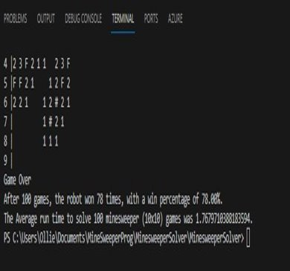
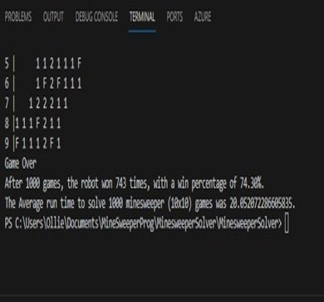
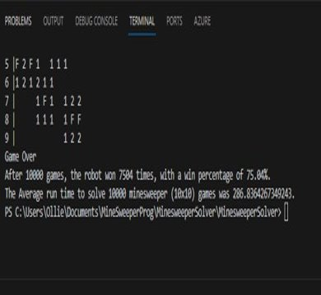
Number of Analysis | Starting Location | Grid Size | Total Games | Win Percentage | Run Time
3 | Top Left Corner | 10x10 | 100 | 78% + 73% + 78% = 76.3% | 1.77 + 1.87 + 1.74= 1.79 seconds
3 | Top Left Corner | 10x10 | 1000 | 74.3% + 73.9% + 76.3% = 74.83% | 20.05 + 22.26 + 22.89 = 21.73 seconds
3 | Top Left Corner | 10x10 | 10000 | 75% + 76.2% + 75.7% = 75.63 | 286.84 + 315.91 + 328.83 = 310.53 seconds
Notes:
The next few slides show the win percentage and run time for each of the test we conducted. We ran each test a total of 3 times and calculate the average win percentage and run time for each of them. The test constants were we always started in the top left corner and grid size was always a 10x10. The changing variable is the Total games played.

Slide 8
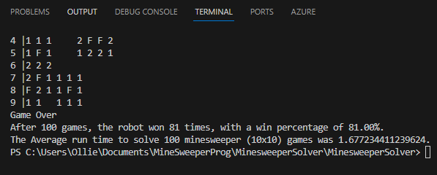
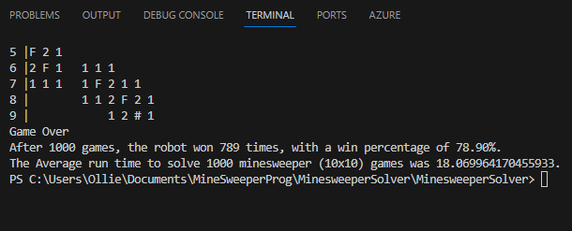
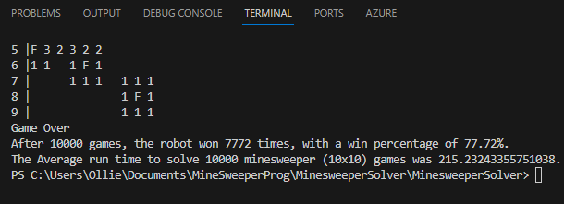
Number of Analysis | Starting Location | Grid Size | Total Games | Win Percentage | Run Time
3 | Random Corner | 10x10 | 100 | (81% + 79% + 81%) / 3 = 80.3% | (1.68 + 1.63 + 1.63) / 3= 1.65 seconds
3 | Random Corner | 10x10 | 1000 | (78.9% + 77.6% + 80.7%) / 3 = 79.07% | (18.07 + 18.77 + 21) / 3 = 19.28 seconds
3 | Random Corner | 10x10 | 10000 | (77.7% + 78.4% + 77.2%) / 3 = 77.77% | (215.23 + 322.17 + 292.93) / 3 = 276.78 seconds
Notes:
The Second test we changed the starting location to any of the 4 random corners and left grid size as a 10x10. The win percentage did increase compare to always picking the top left corner and the Run time did decrease.

Slide 9
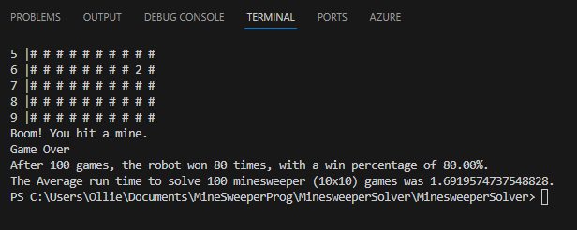
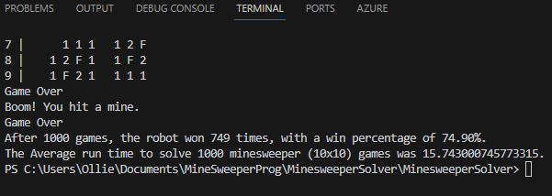
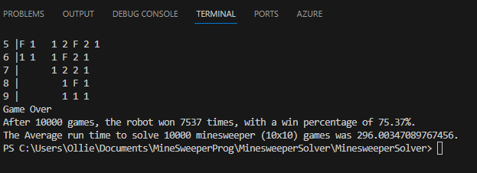
Number of Analysis | Starting Location | Grid Size | Total Games | Win Percentage | Run Time
3 | Random Location | 10x10 | 100 | ( 80% + 74% + 85% ) / 3 = 79.7% | ( 1.69 + 1.54 + 1.7) / 3= 1.64 seconds
3 | Random Location | 10x10 | 1000 | (74.9% + 74.8% + 76.3%) / 3 = 75.33% | (15.74 + 22.54 + 21.83) / 3 = 20.04 seconds
3 | Random Location | 10x10 | 10000 | (75.3% + 75.8 + 74.8) / 3 = 75.3% | (296 + 282.28 + 270.77) / 3 = 283.02 seconds
Notes:
For our third test we changed the starting location to any random location and left grid size as a 10x10. The win percentage was in the middle of our first two test with out any far outliers.

Slide 10
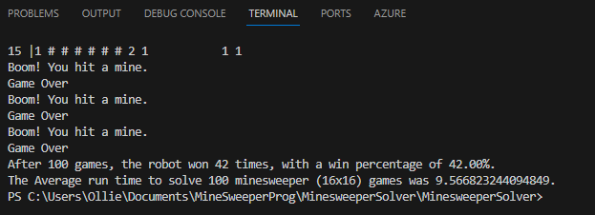
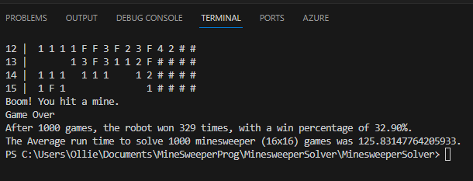
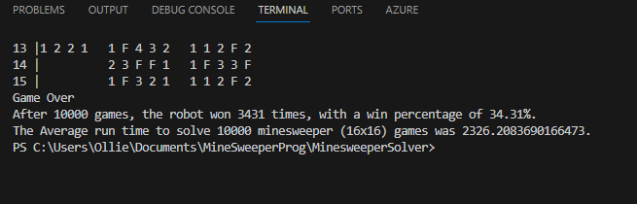
Number of Analysis | Starting Location | Grid Size | Total Games | Win Percentage | Run Time
3 | Top Left Corner | 16x16 | 100 | (42% + 30% + 29%) / 3 = 33.67% | (9.57 + 7.97 + 6.65) / 3 = 8.06 seconds
3 | Top Left Corner | 16x16 | 1000 | (32.9% + 33.8% + 34.5%) / 3= 33.73% | (125.83 + 134.81 + 205.13) / 3 = 155.26 seconds
3 | Top Left Corner | 16x16 | 10000 | (34.31% + 36.73% + 35.46%) / 3 = 35.5% | (2326.29 + 2169.42 + 2276.12) / 3 = 2357.28 seconds
Notes:
For the next three test we change the grid size to 16x16 with 40 mines, to increase the difficult and we went through each starting location for the 3 different total games played. The AI win percentage was consisted for all three test but it did decrease by over half. The run time also increase by 7 to 8 times.

Slide 11
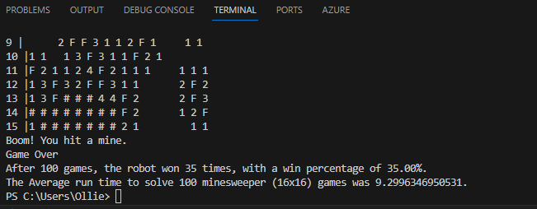
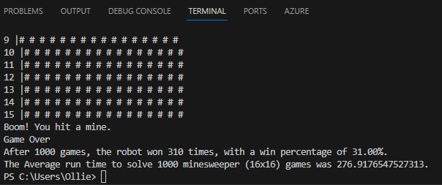
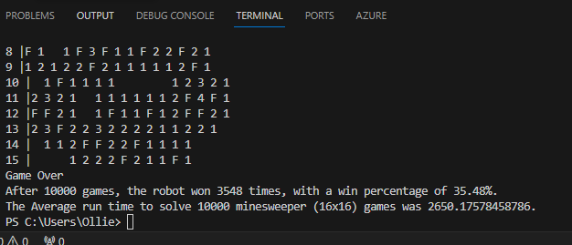
Number of Analysis | Starting Location | Grid Size | Total Games | Win Percentage | Run Time
3 | Random Corner | 16x16 | 100 | (35% + 30% + 22%) / 3 = 29% | (9.3 + 12..37 + 11.09) / 3 = 10.92 seconds
3 | Random Corner | 16x16 | 1000 | (31% + 35.6% + 35.7%) / 3 = 34.1% | (276.92 + 277.27 + 283.07) / 3 = 279.09 seconds
3 | Random Corner | 16x16 | 10000 | (35.48% + 34.6% + 34.7%) / 3 = 34.93% | (2650.18 + 2626.57 + 2583.16) / 3 = 2619.97 seconds

Slide 12
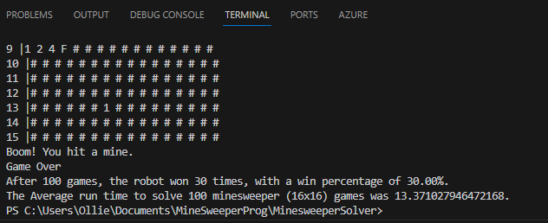
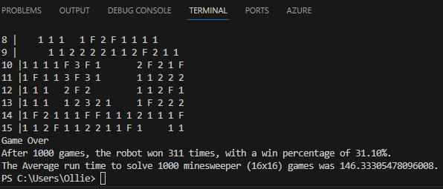
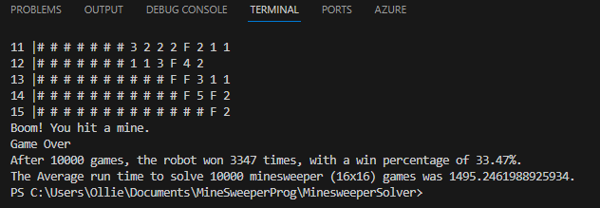
Number of Analysis | Starting Location | Grid Size | Total Games | Win Percentage | Run Time
3 | Random Location | 16x16 | 100 | (30% + 26% + 46%) / 3 = 34% | (13.37 + 13.68 + 9.32) / 3 = 12.12 seconds
3 | Random Location | 16x16 | 1000 | (31.1% + 35.7% + 31.4%) / 3 = 32.73% | (146.33 + 184.87 + 103.37) / 3 = 144.86 seconds
3 | Random Location | 16x16 | 10000 | (33.4% + 34.02% + 34.29%) / 3 = 33.90% | (1495.25 + 1934.17 + 1771) / 3 = 1733.47 seconds

Slide 13
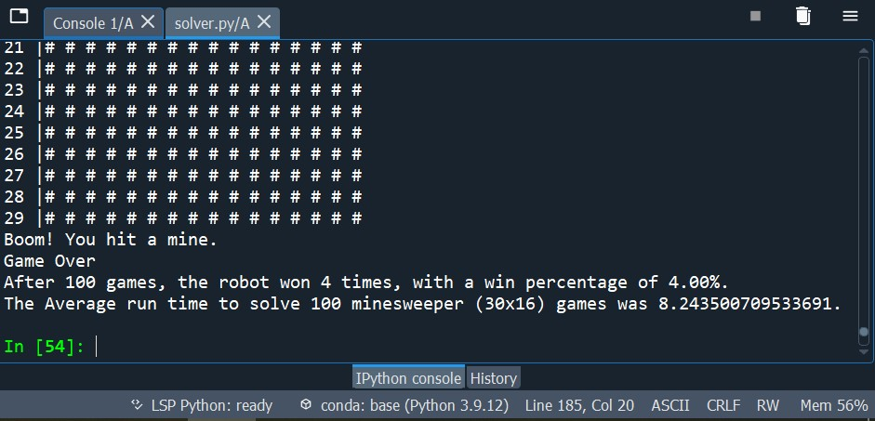
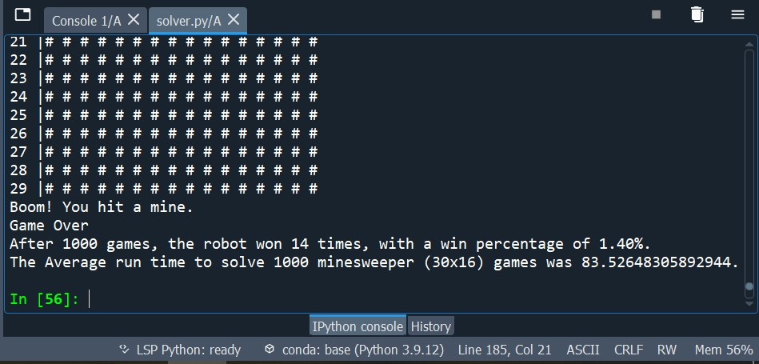
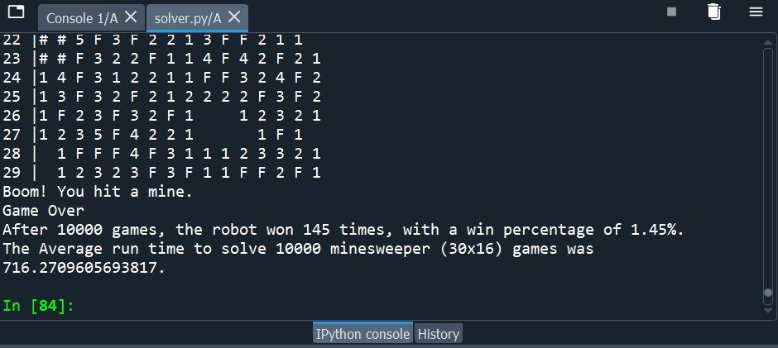
Number of Analysis | Starting Location | Grid Size | Total Games | Win Percentage | Run Time
3 | Top Left Corner | 30x16 | 100 | (4% + 4% + 1%) / 3= 3 % | (8.24 + 8.69 + 7.4) / 3 = 8.11 seconds
3 | Top Left Corner | 30x16 | 1000 | (1.4% + 0.9% + 1.2%) / 3 = 1.17% | (83.52 + 68.25 + 78.08) / 3 = 76.61 seconds
3 | Top Left Corner | 30x16 | 10000 | (1.45% + 1.37% + 1.21%) / 3 = 1.34% | ( 716.27 + 676.32 + 749.51) / 3 = 704.03 seconds
Notes:
For our final set of three test, we conducted them using an expert level board. The grid size was increase to 30x16 and continued 99 random mines. Through these test we conclude that the AI struggle to win games. It was impressive that it was able to win any at all and would probably require a lot more logic in its decision making. The run time for each of the total games played decreased most likely due to the AI losing faster.

Slide 14
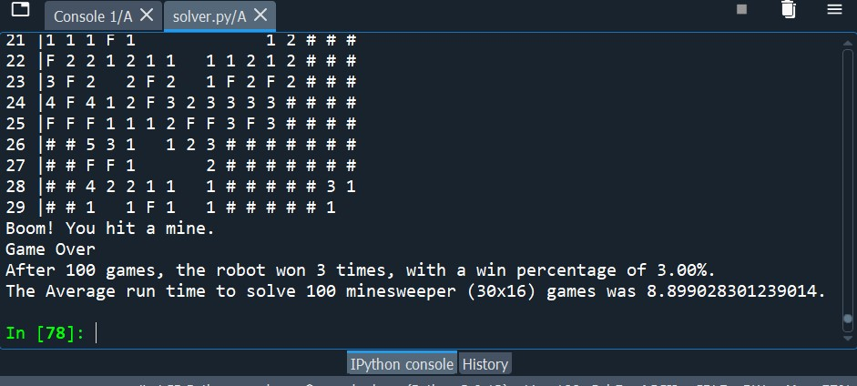
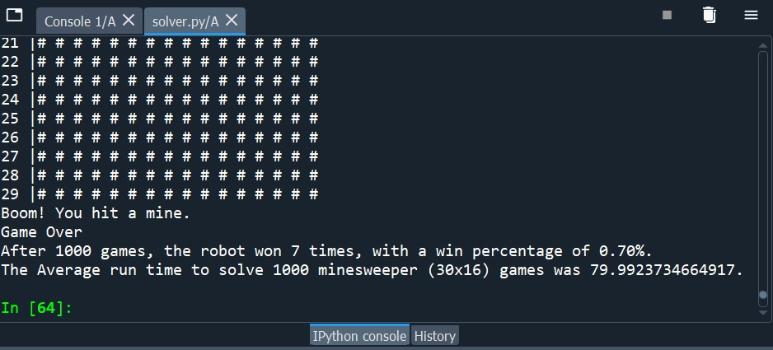
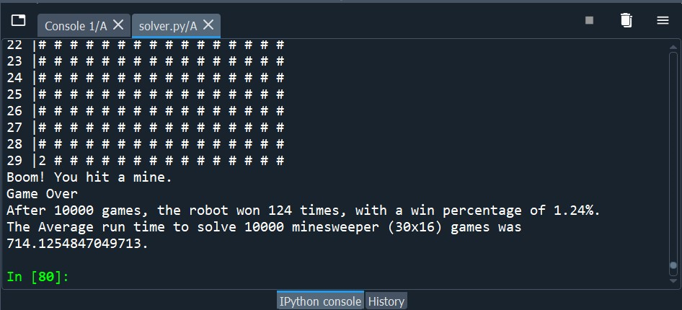
Number of Analysis | Starting Location | Grid Size | Total Games | Win Percentage | Run Time
3 | Random Corner | 30x16 | 100 | (3% + 2% + 1%) / 3 = 2% | (8.9 + 9.47 + 8.53) / 3 = 10.62 seconds
3 | Random Corner | 30x16 | 1000 | (.7% + 1% + 1.6%) / 3 = 1.1% | (79.99 + 68.57 + 77.12) / 3 = 75.23 seconds
3 | Random Corner | 30x16 | 10000 | (1.24% + 1.22% 1.18%) / 3 = 1.2% | (714.13 + 706.24 + 785.72) / 3 = 735.36 secones

Slide 15
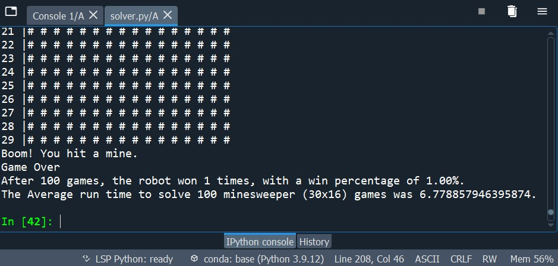
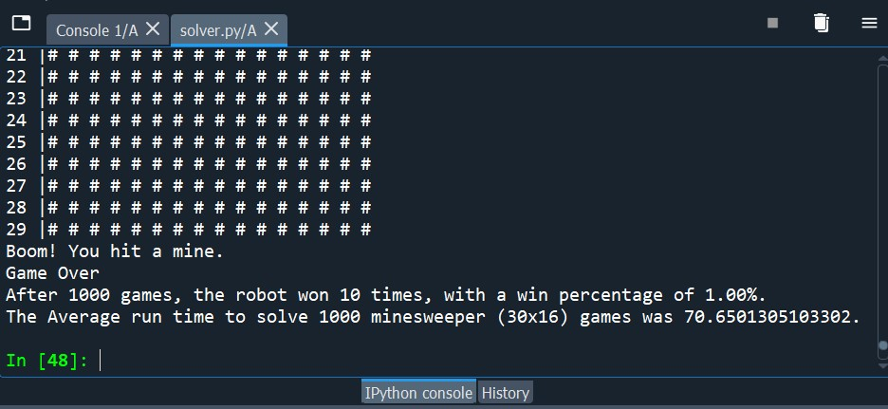
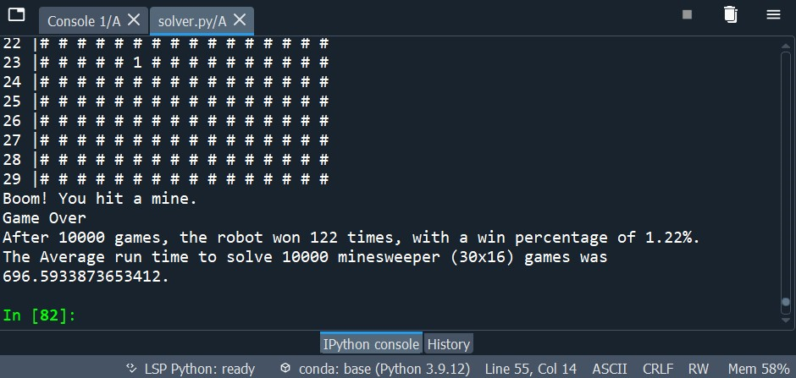
Number of Analysis | Starting Location | Grid Size | Total Games | Win Percentage | Run Time
3 | Random Location | 30x16 | 100 | (1% + 1% + 1%) / 3 = 1% | (6.78 + 5.81 + 6.94) / 3 = 6.51 seconds
3 | Random Location | 30x16 | 1000 | (1% + .9% + 1%) / 3 = .96% | (70.65 + 66.23 + 66.82) / 3 = 67.9 seconds
3 | Random Location | 30x16 | 10000 | ( 1.22% + 1.36 + 1.15) / 3 = 1.24 % | (696.59 + 702.61 + 730.26) = 709.82 seconds

Slide 16
Analysis Results
Minesweeper is a game that will always require both human and AI players to make the best random guess they can based on limited to no information. It is impossible to achieve 100% win rate in minesweeper due to your first move having a 50% chance of being a bomb. We tested this theory with our three different starting move locations, which concluded similar results for all three difficulty levels. However, after the first move is discovered to be safe, the AI can make smarter decisions as more logic is provided to it. Different scenario would have to be account for and the possible decision would need to be ranked by priority for the AI to cycle through.

Slide 17

Questions
Notes:
Do we have any questions?

